Slide 1
PEGASUS:Pre-training with
Extracted Gap-sentences for Abstractive Summarization
Guided By : Prof. Dr.Brijesh Bhatt
Prof. Siddharth Shah
Prepared By : Darshan Tank

Slide 2
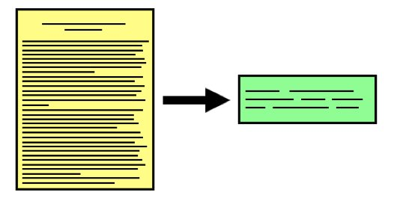
Text summarization.
Types of summarization
Abstractive
Extractive

Slide 3
How machine gonna achieve this task ?
Seq2Seq
RNN ( LSTM, GRUs ).
Encoder-Decoder mechanism, Context vector.
Issue With RNN based model
What if we have powerful machine with high class GPUs. Will we able to utilize that power of machine with RNN.
Loss of information Gain & Vanishing Gradient
Unidirectional context only
Transformation from RNN to TRANSFORMER.
Self-Attention with multiple-Head (Parallel Computing.)
Positional Encoding.
Bidirectional context
Notes:
Self-attention : ”The animal didn't cross the street because it was too tired”

Slide 4
Transformers are Data Hungry !
Introduction to Pre-training and Fine-tuning.
Pre-training models and Pre-Training objectives
MASS : MAsked Sequence to Sequence
UniLM : unidirectional, bidirectional, Sequence-to-Sequence(word level)
T5 : randomly corrupted text spans
BART : corrupted text with an arbitrary noising function
MLM : Mask language modeling
What PEGASUS has proposed to Perform Abstractive Text Summarization?
Introduction to GSG(Gap-Sentence-Generation)
How to select Gap-Sentences?
Randomly
Lead
Principal - ROUGE1-F1
Independently
Sequentially

Slide 5

Random
Lead
Principal

Slide 6
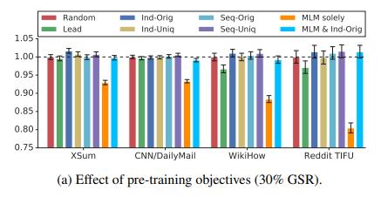
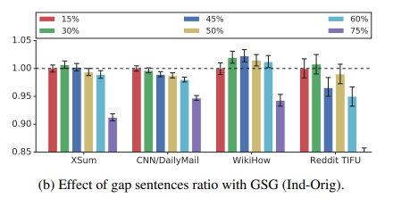
How many sentences should be masked?
GSR(Gap Sentences Ration)
From the diagrams we can see that GSR value 15% & 30% works well for all the given data set.

Slide 7
Now, We have everything with us let’s start experiment.
 | Batch Size | Parameters | Data-Set | Number of layers for encoder-decoder(L) | Hidden layer size(H) | Feed-Forward layer size(F) | Number of Self-Attention head(A)
PEGASUS_{BASE} | 256 | 223M | 4 | 12 | 768 | 3072 | 12
PEGASUS_{LARGE} | 8192 | 568M | 12 | 16 | 1024 | 4096 | 16
Vocabulary Option = Unigram with size of 96k
Gradient descent = For optimization, both pre-training and fine-tuning used Adafactor (Shazeer & Stern, 2018) with square root learning rate decay and dropout rate of 0.1.
Notes:
Tokenization methods :
Byte-Pair-Encoding algorithm (BPE)
2.) SentencePiece Unigram algorithm (subword tokenization)ex. Smartest => smart + est ; newer => new + er

Slide 8
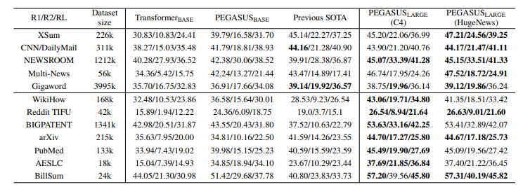
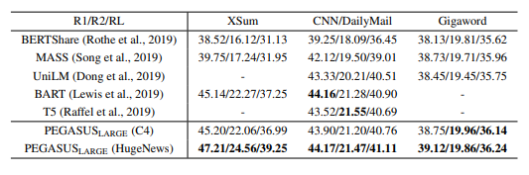
Final Output :

Slide 9
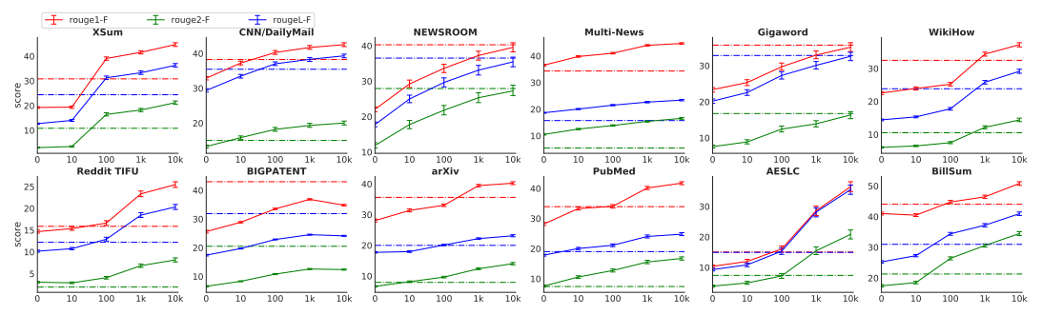
Difficulty to collect a large number of supervised examples to train or fine-tune a summarization model.
low-resource summarization setting (picked the first 10^{k} (k = 1, 2, 3, 4) training examples from each dataset to fine-tune PEGASUS_{LARGE}).
Solid lines PEGASUS_{LARGE}
Dashed lines Transformer_{BASE} models (equivalent in capacity as PEGASUS_{BASE})

Slide 10
Conclusion :
Goal : Abstractive Summarization
Solution : PEGASUS
Pre-training Data-set : C4 and HugeNews
Fine-tuning Data-set : List of 12 Data-sets
DownStream Task : Abstractive Summarization
Pre-training Model : GSG(Gap-Sentence-Generation)
Which Gap-sentences : Principal approach (Independent-Original)
GSR value : 15%
Gradient Descent Algo : Adafactor
Vocabulary Size : Unigram with size of 96k
Parameters : 568M
Notes:
The main idea behind this objective is the assumption that, closer the pre-training self-supervised objective is to the final downstream task, the better the fine-tuning performance.

